Slide 1


Slide 2

Brief Intro on Me
Software Technical Lead @ Applied Materials India
Tech/Auto/Film Enthusiast
Committed to sharing practical insights and effective debugging strategies.
linkedin.com/in/vishnu-gopinath-831376108/
Notes:
<number>

Slide 3
The Silent Threat
Why Care About Concurrency Bugs?
Hard to Detect
Severe Impact
Costly in Production
Concurrency bugs are notoriously difficult to find and reproduce, often manifesting inconsistently.
They lead to unpredictable crashes, data corruption, and critical performance degradation.
Finding these bugs late in the development cycle or, worse, in production, can cost significant time and damage reputation.
Notes:
<number>

Slide 4
Real-World Examples: Concurrency Bugs Exposed
Linux Kernel Privilege
Escalation
Google Chrome (2022)
Boeing 787 Dreamliner
What happened: Race condition in Linux kernel’s copy-on-write let unprivileged users write to read-only memory.
Impact: Local users could gain root access, affected nearly all Linux and Android systems.
Root cause: Improper synchronization between memory check and write.
Action: Emergency patches released across all major distributions.
What happened: A race condition in the animation component enabled arbitrary code execution (CVE-2022-0609).
Impact: Exploited in zero-day attacks by state-sponsored actors.
Severity: Critical, allowing remote code execution.
Fix: Google promptly patched and urged browser updates.
What happened: FAA alert (2019) for a race condition in flight control software.
Impact: Continuous operation for 248 days could lead to complete loss of flight controls due to a system timer wraparound.
Severity: Catastrophic if triggered.
Fix: Required software update and recommended periodic system resets.
Notes:
<number>

Slide 5

The Solution
What is Thread Sanitizer (TSan)?
A powerful dynamic analysis tool for detecting data races and other synchronization issues in C++ code.
Integrated into popular compilers like LLVM/Clang
and GCC.
Works by instrumenting code during compilation to monitor memory and synchronization operations.
Provides detailed reports at runtime when concurrency bugs are detected.
Notes:
<number>

Slide 6
The Evolution of Thread Sanitizer (TSan)
From an internal Google tool to an industry-standard open-source solution, TSan has a rich history of development and adoption.
2009–2010: Origins as a Valgrind Tool
Developed internally at Google by Konstantin Serebryany and team. Initially a Valgrind tool, it was slow (~20-50x slowdown) but proved effective in finding race conditions in large codebases like Chrome.
2011–2012: Shift to Compiler Integration (TSan v2)
Due to Valgrind's performance limitations, TSan was reimplemented as a compiler-based instrumentation tool within LLVM/Clang. This significantly reduced overhead (~5-15x), marking the birth of ThreadSanitizer v2.
2013–2014: Public Release & GCC Integration
TSan was open-sourced and integrated into LLVM and GCC, making it accessible to the broader developer community. It became a key part of the AddressSanitizer family and was adopted as the default race detection tool for Chromium.
2015–2018: Widespread Adoption in Industry
Chromium integrated TSan into its continuous integration pipelines, preventing new race conditions. Major tech companies like Google and Facebook adopted TSan for testing, extending its availability across various operating systems.
2019–Present: Modern Era & Ongoing Development
TSan continues to evolve, supporting modern C++ threading models (C++11/14/17) and Go language concurrency. Its integration with fuzzing techniques (libFuzzer) has become crucial for uncovering rare race conditions in automated CI/CD pipelines.
Notes:
<number>

Slide 7

Beyond Data Races
Common Bugs Detected by TSan
Data Races
Mutex Issues
Unsynchronized accesses to shared variables that can lead to unpredictable behavior.
Detection of uninitialized mutexes, or unlocking a mutex that wasn't locked by the current thread.
Use-After-Free
Lock Ordering
Detects memory corruption issues when memory is accessed after being deallocated, particularly in multithreaded scenarios.
Identifies potential deadlocks due to inconsistent lock acquisition order.
Notes:
<number>

Slide 8

A Simple Case
Example: Race Condition in C++
int counter = 0;
void increment()
{
counter++;
}
int main()
{
std::thread t1(increment);
std::thread t2(increment);
t1.join();
t2.join();
return 0;
}
TSan Output: This code will typically report a data race on the counter variable because both threads access and
modify it without proper synchronization, leading to an unpredictable final value.
Notes:
<number>

Slide 9
Seamless Integration
Integrating TSan in Your Build
Compilation Flags
Workflow
To enable TSan, compile your C++ code with the following flags for Clang or GCC:
Run Tests: Execute your test binaries as you normally would.
Analyze Reports: TSan will print race reports to stderr upon detection.
-fsanitize=thread -g
CI Integration: Incorporate TSan runs into your Continuous Integration (CI) pipeline for early detection of concurrency issues.
The -g flag includes debug information, which is crucial for detailed TSan reports.
Notes:
<number>

Slide 10
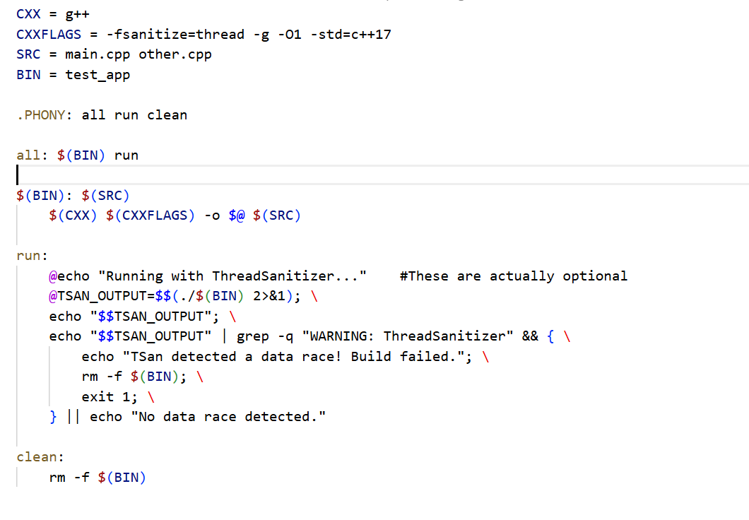

Slide 11
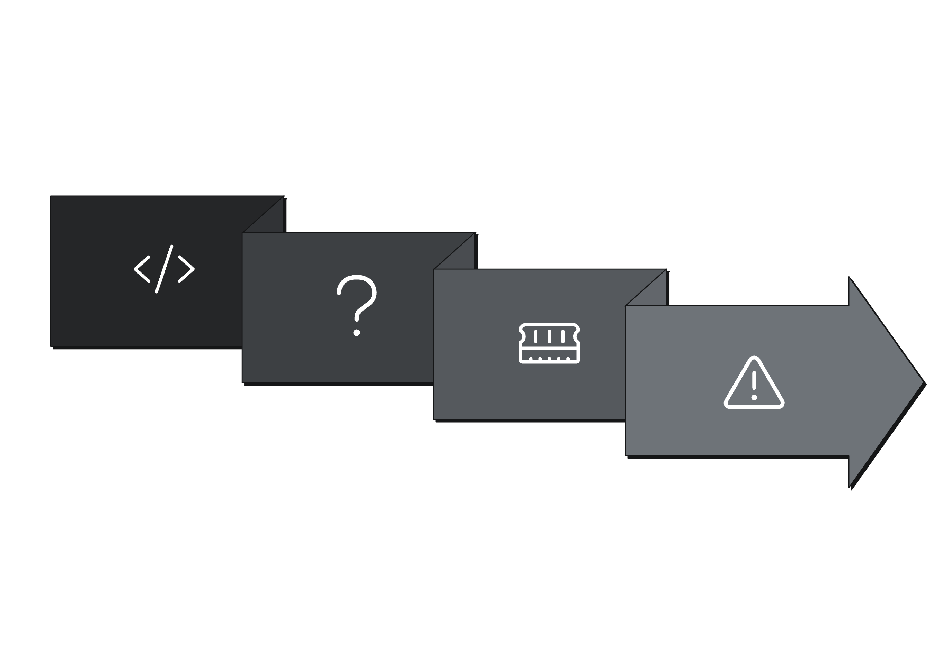




Under the Hood
How Thread Sanitizer Works
Happens-Before Graph
Detect Data Races
Code Instrumentation
Shadow Memory
Notes:
<number>

Slide 12

Instrumentation: TSan's Compiler Magic
The Compiler's Role:
Inserts Hooks: The compiler strategically adds
instrumentation before every memory access (read/write).
Adds Runtime Calls: It injects calls to TSan runtime functions
(e.g., __tsan_readN, __tsan_writeN) for monitoring.
Wraps Synchronizations: Synchronization primitives (mutexes, atomics)
are replaced with TSan-aware versions.
Manages Shadow Memory: Special "shadow memory" is maintained to record access details like address, size, and thread context.
Tracks Happens-Before: TSan builds a "happens-before" graph to accurately determine causal relationships between operations.
Example:
x = 42; // Compiler might emit:// __tsan_write8(&x);
// x = 42;
This simple assignment illustrates how TSan inserts a call to __tsan_write8 before the actual write, allowing it to track the operation.
Notes:
<number>

Slide 13
Under the Hood
How Thread Sanitizer Works
Happens-Before Graph
Detect Data Races
Code Instrumentation
Shadow Memory
Notes:
<number>

Slide 14
Under the Hood
Happens-Before Tracking
The Happens-Before Rule
How TSan Implements It
Vector Clocks Basics: Each thread maintains a vector clock, which is an array of logical timestamps (one for each thread in the system). It represents what the current thread "knows" about the progress of other threads.
If thread A releases a mutex and thread B subsequently acquires the same mutex, all operations before the release in A are ordered before all operations after the acquire in B.
If no such "happens-before" relationship exists between two conflicting memory accesses (e.g., a read and a write to the same location), TSan flags a potential data race.
Synchronization Updates: TSan updates these vector clocks during synchronization events (e.g., mutex locks/unlocks, atomic operations, thread joins). For instance, when Thread A unlocks a mutex, its current vector clock is "attached" to the mutex.
Clock Merging: When Thread B locks that same mutex, it merges the mutex's stored vector clock into its own. This merge effectively communicates: "Thread B now incorporates all the knowledge of Thread A's progress up to the point it released the mutex."
A
B
Notes:
<number>

Slide 15
Under the Hood
How Thread Sanitizer Works
Happens-Before Graph
Detect Data Races
Code Instrumentation
Shadow Memory
Notes:
<number>

Slide 16
Under the Hood
Happens-Before in Action: Mutex Example
C++ Code Example
Vector Clock Walkthrough
std::mutex m;
int x = 0;
void threadA()
{
std::lock_guard<std::mutex> lock(m);
x = 42; // write
}
void threadB()
{
std::lock_guard<std::mutex> lock(m);
std::cout << x; // read
}
A releases lock L
Initial state: A: [2,0], B: [0,0]. When A releases lock L, its current vector clock is stored with the lock.
LockClock[L] = [2,0]
B acquires lock L
B merges the lock's stored clock with its own, incorporating A's progress up to the release point.
B = max( [0,0], [2,0] ) = [2,0]
Now B's clock indicates knowledge of A's operations up to time 2.
B increments local time
After performing its work,
T1 updates its own local component of the vector clock.
B = [2,1]
This ensures its subsequent operations are ordered after
its current actions.
Notes:
<number>

Slide 17


Maximizing Effectiveness
Best Practices for TSan
Test New Code
Combine Sanitizers
Always run TSan on new code paths and complex concurrent sections.
Use alongside AddressSanitizer (ASan) and UndefinedBehaviorSanitizer (UBSan) for comprehensive error detection.
Annotate Benign Races
Dedicated Environments
Use TSan suppression mechanisms to mark intentional benign races and reduce noise in reports.
Run TSan in isolated test environments, as it introduces significant performance overhead.
Notes:
<number>

Slide 18

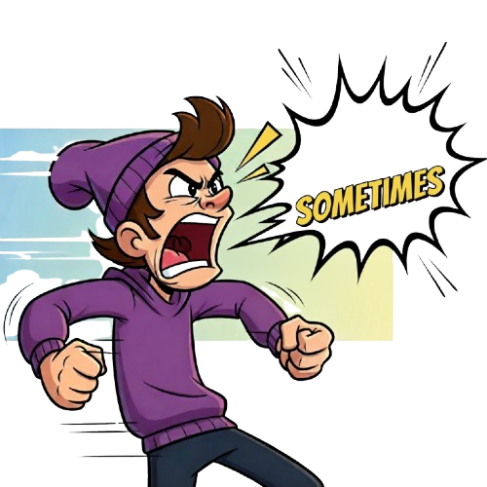
Know the Boundaries
Limitations of Thread Sanitizer
Performance Overhead: Typically introduces a 3x-5x slowdown, making it unsuitable for production environments.
Build Requirement: Requires instrumented builds; cannot be used directly on uninstrumented production binaries.
Specific Focus: Primarily targets data races and synchronization errors; does not directly catch logical bugs or deadlocks (though it can help expose conditions that lead to them).
False Negatives: While powerful, it might miss some complex concurrency issues due to dynamic analysis limitations.
Notes:
<number>

Slide 19
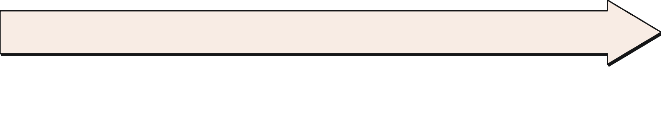

Key Takeaways
Sanitize Before You Ship It!
TSan is Essential
Integrate Early
A powerful tool for proactively identifying hidden race conditions and other concurrency bugs.
Embedding TSan into your development workflow and CI pipeline dramatically improves code quality and reliability.
Avoid Production Headaches
Continuous Improvement
Don't wait for elusive concurrency bugs to emerge in production; catch them when they are cheapest to fix.
Regular use of TSan fosters robust, predictable, and high-performance multithreaded applications.
Notes:
<number>

Slide 20
Thank You…

